Slide 1

Chapter 17
Creating User Interfaces

Slide 2
Motivations
A graphical user interface (GUI) makes a system user-friendly and easy to use. Creating a GUI requires creativity and knowledge of how GUI components work. Since the GUI components in Java are very flexible and versatile, you can create a wide assortment of useful user interfaces.
Previous chapters briefly introduced several GUI components. This chapter introduces the frequently used GUI components in detail.

Slide 3
Objectives
To create graphical user interfaces with various user-interface components: JButton, JCheckBox, JRadioButton, JLabel, JTextField, JTextArea, JComboBox, JList, JScrollBar, and JSlider (§§17.2–17.11).
To create listeners for various types of events (§§17.2–17.11).
To explore JButton (§17.2)
To explore JCheckBox (§17.3)
To explore JRadioButton (§17.4)
To explore JLabel (§17.5)
To explore JTextField (§17.6)
To explore JTextArea (§17.7)
To explore JComboBox (§17.8)
To explore JList (§17.9)
To explore JScrollBar (§17.10)
To explore JSlider (§17.11)
To display multiple windows in an application (§17.12).

Slide 4
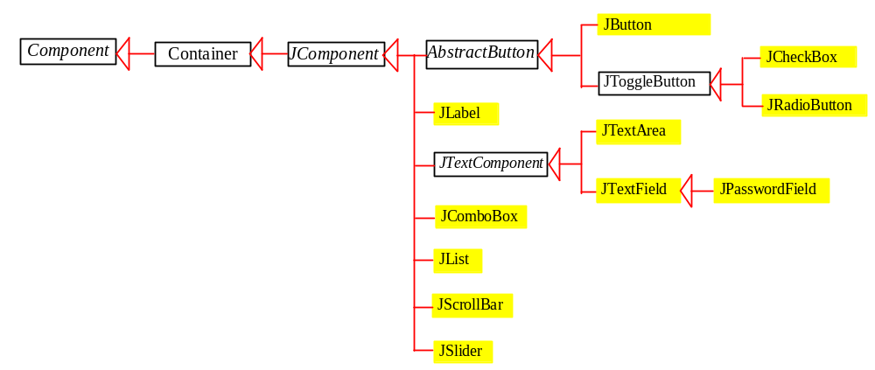
Components Covered in the Chapter
Introduces the frequently used GUI components
Uses borders and icons

Slide 5
Buttons
A button is a component that triggers an action event when clicked. Swing provides regular buttons, toggle buttons, check box buttons, and radio buttons. The common features of these buttons are generalized in javax.swing.AbstractButton.

Slide 6
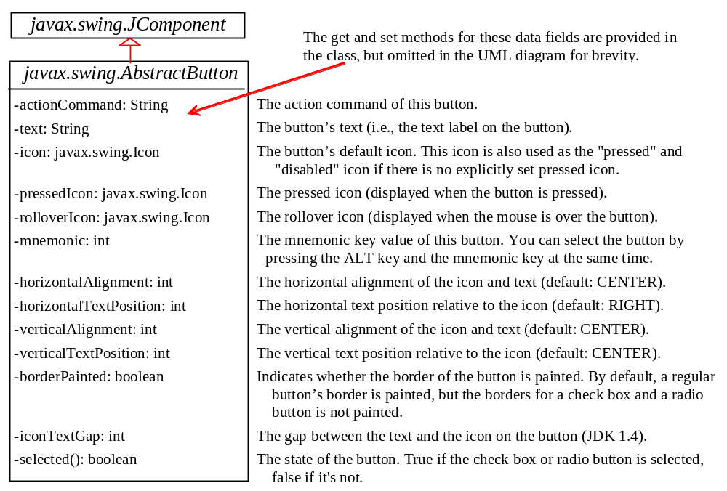
AbstractButton

Slide 7
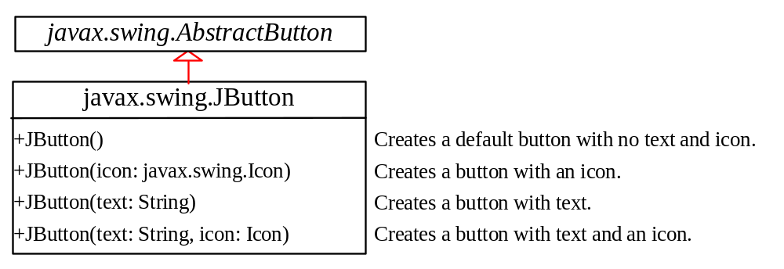
JButton
JButton inherits AbstractButton and provides several constructors to create buttons.

Slide 8
JButton Constructors
The following are JButton constructors:
JButton()
JButton(String text)
JButton(String text, Icon icon)
JButton(Icon icon)

Slide 9
JButton Properties
text
icon
mnemonic
horizontalAlignment
verticalAlignment
horizontalTextPosition
verticalTextPosition
iconTextGap

Slide 10

Default Icons, Pressed Icon, and Rollover Icon
A regular button has a default icon, pressed icon, and rollover icon. Normally, you use the default icon. All other icons are for special effects. A pressed icon is displayed when a button is pressed and a rollover icon is displayed when the mouse is over the button but not pressed.
(A) Default icon (B) Pressed icon (C) Rollover icon

Slide 11
Demo
TestButtonIcons
Run

Slide 12
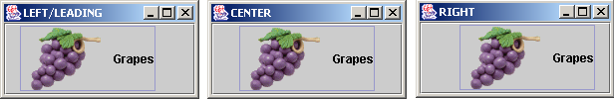
Horizontal Alignments
Horizontal alignment specifies how the icon and text are placed horizontally on a button. You can set the horizontal alignment using one of the five constants: LEADING, LEFT, CENTER, RIGHT, TRAILING. At present, LEADING and LEFT are the same and TRAILING and RIGHT are the same. Future implementation may distinguish them. The default horizontal alignment is SwingConstants.TRAILING.

Slide 13
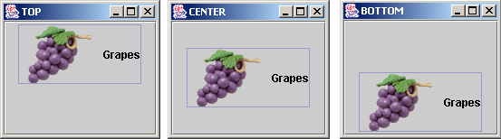
Vertical Alignments
Vertical alignment specifies how the icon and text are placed vertically on a button. You can set the vertical alignment using one of the three constants: TOP, CENTER, BOTTOM. The default vertical alignment is SwingConstants.CENTER.

Slide 14
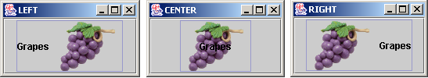
Horizontal Text Positions
Horizontal text position specifies the horizontal position of the text relative to the icon. You can set the horizontal text position using one of the five constants: LEADING, LEFT, CENTER, RIGHT, TRAILING. The default horizontal text position is SwingConstants.RIGHT.

Slide 15

Vertical Text Positions
Vertical text position specifies the vertical position of the text relative to the icon. You can set the vertical text position using one of the three constants: TOP, CENTER. The default vertical text position is SwingConstants.CENTER.

Slide 16
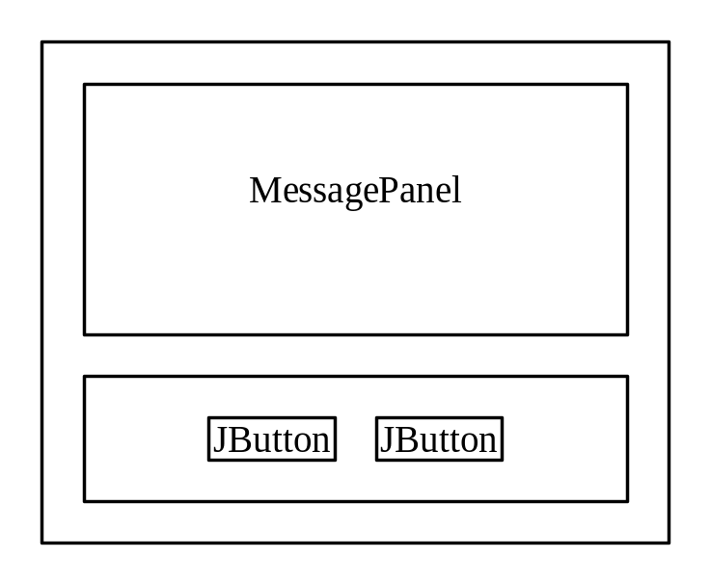
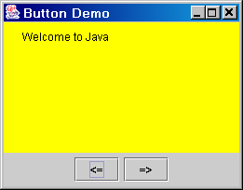
Example: Using Buttons
Write a program that displays a message on a panel and uses two buttons, <= and =>, to move the message on the panel to the left or right.
ButtonDemo
Run

Slide 17
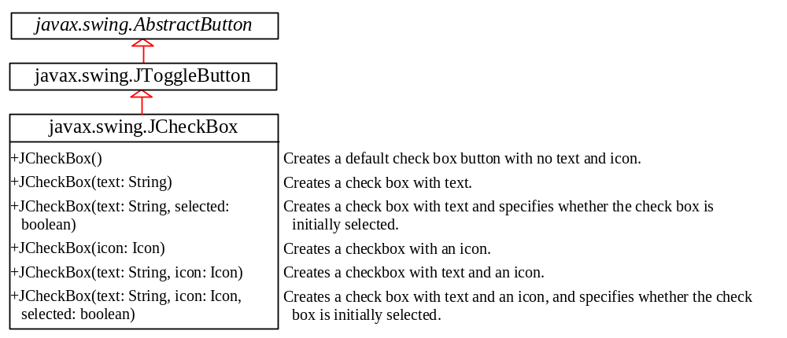
JCheckBox
JCheckBox inherits all the properties such as text, icon, mnemonic, verticalAlignment, horizontalAlignment, horizontalTextPosition, verticalTextPosition, and selected from AbstractButton, and provides several constructors to create check boxes.

Slide 18
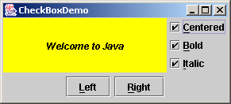
Example: Using Check Boxes
Add three check boxes named Centered, Bold, and Italic into the ButtonDemo example to let the user specify whether the message is centered, bold, or italic.
ButtonDemo
CheckBoxDemo
CheckBoxDemo
Run

Slide 19
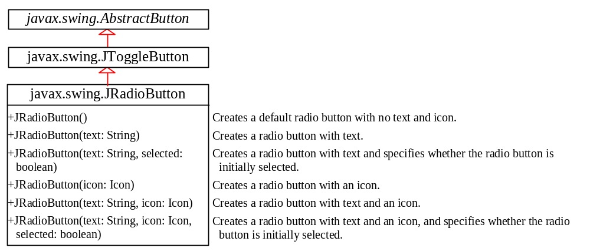
JRadioButton
Radio buttons are variations of check boxes. They are often used in the group, where only one button is checked at a time.

Slide 20
Grouping Radio Buttons
  ButtonGroup btg = new ButtonGroup();
  btg.add(jrb1);
  btg.add(jrb2);

Slide 21
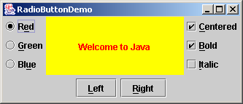
Example: Using Radio Buttons
Add three radio buttons named Red, Green, and Blue into the preceding example to let the user choose the color of the message.
ButtonDemo
CheckBoxDemo
RadioButtonDemo
RadioButtonDemo
Run

Slide 22
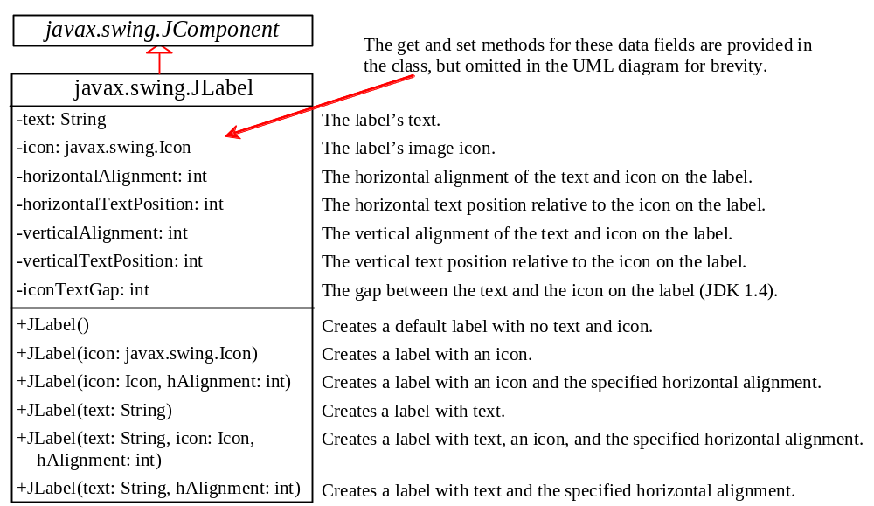
JLabel
A label is a display area for a short text, an image, or both.

Slide 23
JLabel Constructors
The constructors for labels are as follows:
JLabel()
JLabel(String text, int horizontalAlignment)
JLabel(String text)
JLabel(Icon icon)
JLabel(Icon icon, int horizontalAlignment)
JLabel(String text, Icon icon, int horizontalAlignment)

Slide 24
JLabel Properties
JLabel inherits all the properties from JComponent and has many properties similar to the ones in JButton, such as text, icon, horizontalAlignment, verticalAlignment, horizontalTextPosition, verticalTextPosition, and iconTextGap.

Slide 25
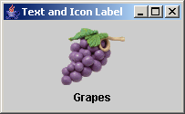
Using Labels
// Create an image icon from image file
ImageIcon icon = new ImageIcon("image/grapes.gif");
// Create a label with text, an icon,
// with centered horizontal alignment
JLabel jlbl = new JLabel("Grapes", icon, SwingConstants.CENTER);
// Set label's text alignment and gap between text and icon
jlbl.setHorizontalTextPosition(SwingConstants.CENTER);
jlbl.setVerticalTextPosition(SwingConstants.BOTTOM);
jlbl.setIconTextGap(5);

Slide 26
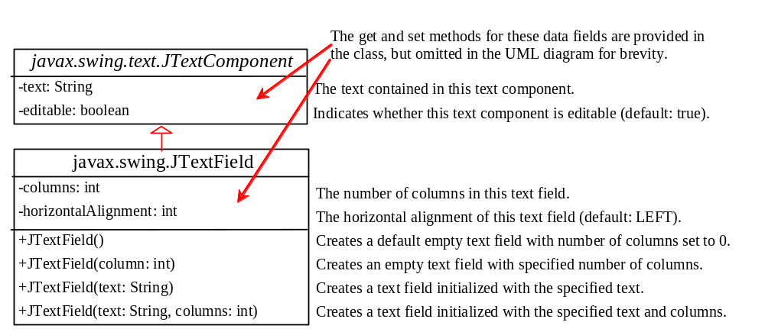
JTextField
A text field is an input area where the user can type in characters. Text fields are useful in that they enable the user to enter in variable data (such as a name or a description).

Slide 27
JTextField Constructors
JTextField(int columns)
Creates an empty text field with the specified number of columns.
JTextField(String text)
Creates a text field initialized with the specified text.
JTextField(String text, int columns)
Creates a text field initialized with the
specified text and the column size.

Slide 28
JTextField Properties
text
horizontalAlignment
editable
columns

Slide 29
JTextField Methods
getText()
Returns the string from the text field.
setText(String text)
Puts the given string in the text field.
setEditable(boolean editable)
Enables or disables the text field to be edited. By default, editable is true.
setColumns(int)
Sets the number of columns in this text field.
The length of the text field is changeable.

Slide 30
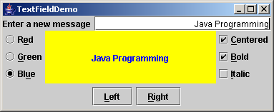
Example: Using Text Fields
Add a text field to the preceding example to let the user set a new message.
TextFieldDemo
Run

Slide 31
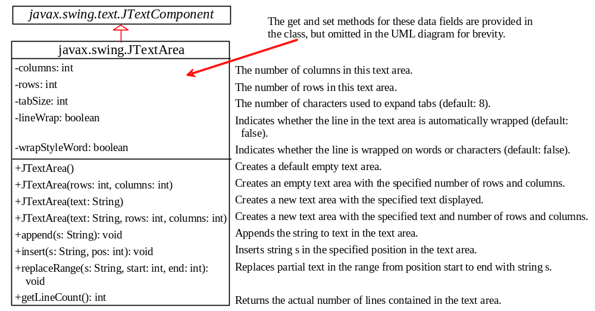
JTextArea
If you want to let the user enter multiple lines of text, you cannot use text fields unless you create several of them. The solution is to use JTextArea, which enables the user to enter multiple lines of text.

Slide 32
JTextArea Constructors
JTextArea(int rows, int columns)
Creates a text area with the specified number of rows and columns.
JTextArea(String s, int rows, int columns)
Creates a text area with the initial text and
the number of rows and columns specified.

Slide 33
JTextArea Properties
text
editable
columns
lineWrap
wrapStyleWord
rows
lineCount
tabSize

Slide 34
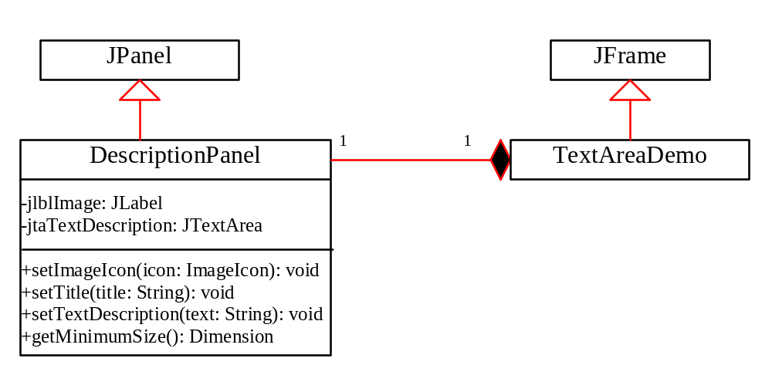
Example: Using Text Areas
This example gives a program that displays an image in a label, a title in a label, and a text in a text area.

Slide 35
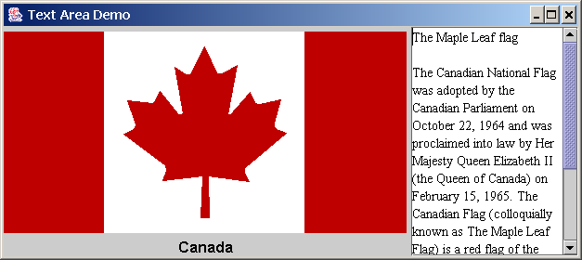
Example, cont.
TextAreaDemo
Run

Slide 36
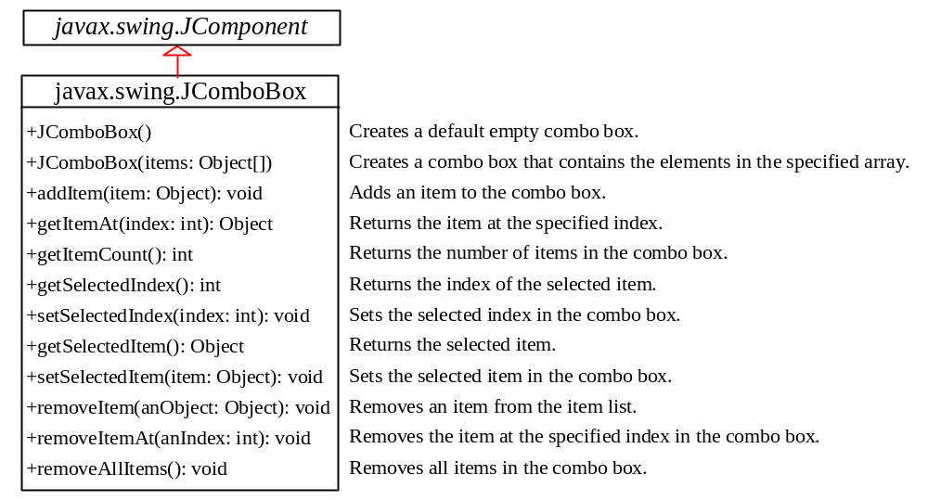
JComboBox
A combo box is a simple list of items from which the user can choose. It performs basically the same function as a list, but can get only one value.

Slide 37
JComboBox Methods
To add an item to a JComboBox jcbo, use
jcbo.addItem(Object item)
To get an item from JComboBox jcbo, use
jcbo.getItem()

Slide 38
Using the itemStateChanged Handler
When a choice is checked or unchecked, itemStateChanged() for ItemEvent is invoked as well as the actionPerformed() handler for ActionEvent.
public void itemStateChanged(ItemEvent e) {
// Make sure the source is a combo box
if (e.getSource() instanceof JComboBox)
String s = (String)e.getItem();
}

Slide 39
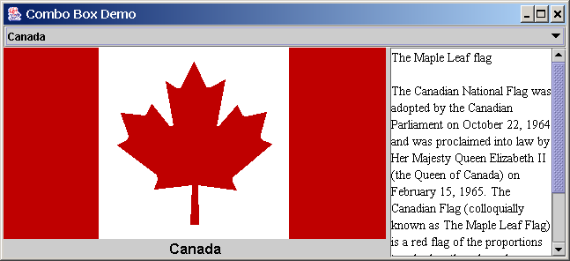
Example: Using Combo Boxes
This example lets users view an image and a description of a country's flag by selecting the country from a combo box.
ComboBoxDemo
Run

Slide 40
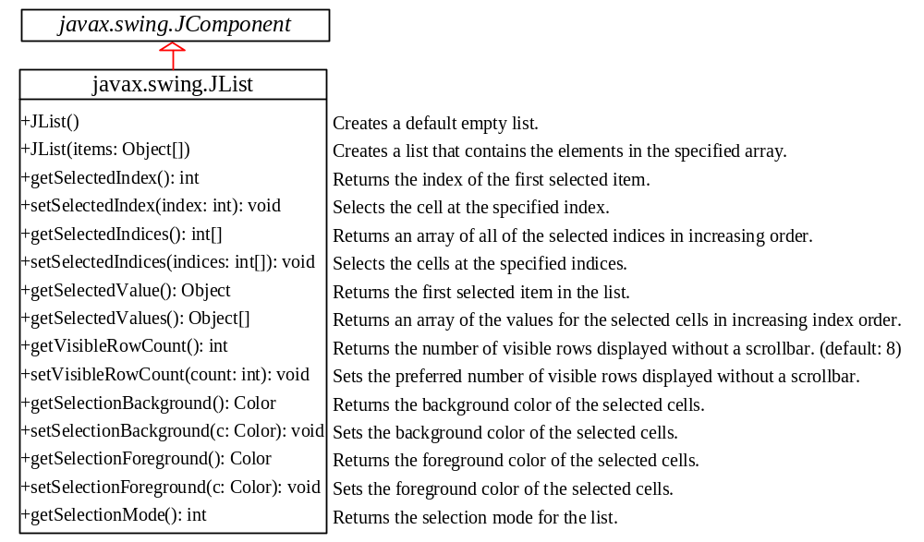
JList
A list is a component that performs basically the same function as a combo box, but it enables the user to choose a single value or multiple values.

Slide 41
JList Constructors
JList()
Creates an empty list.
JList(Object[] stringItems)
Creates a new list initialized with items.

Slide 42
JList Properties
selectedIndexd
selectedIndices
selectedValue
selectedValues
selectionMode
visibleRowCount

Slide 43
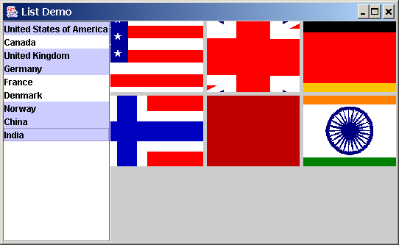
Example: Using Lists
This example gives a program that lets users select countries in a list and display the flags of the selected countries in the labels.
ListDemo
Run

Slide 44
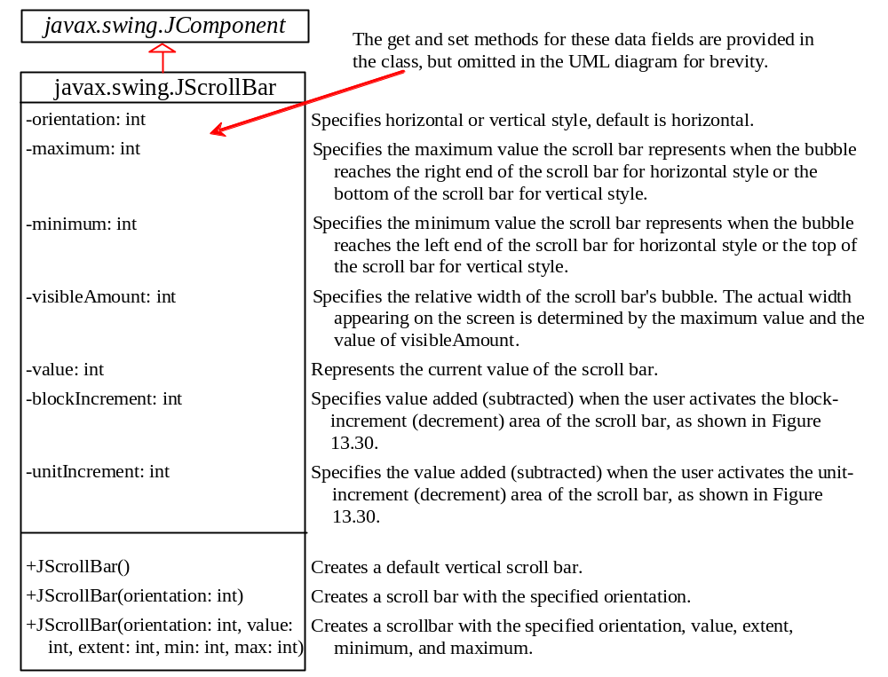
JScrollBar
A scroll bar is a control that enables the user to select from a range of values. The scrollbar appears in two styles: horizontal and vertical.

Slide 45
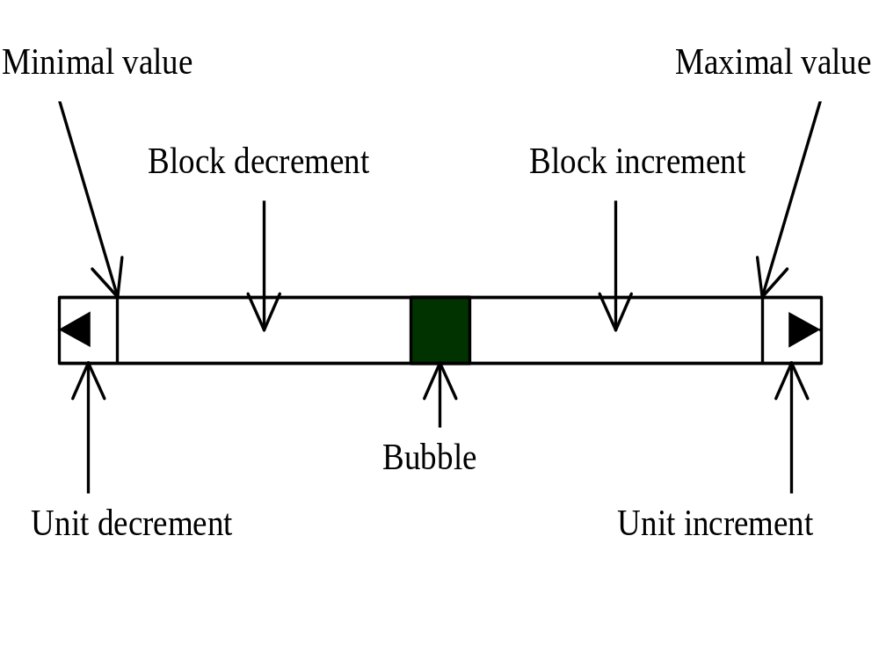
Scroll Bar Properties

Slide 46
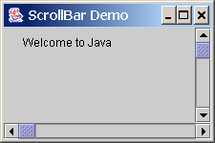
Example: Using Scrollbars
This example uses horizontal and vertical scrollbars to control a message displayed on a panel. The horizontal scrollbar is used to move the message to the left or the right, and the vertical scrollbar to move it up and down.
ScrollBarDemo
Run

Slide 47
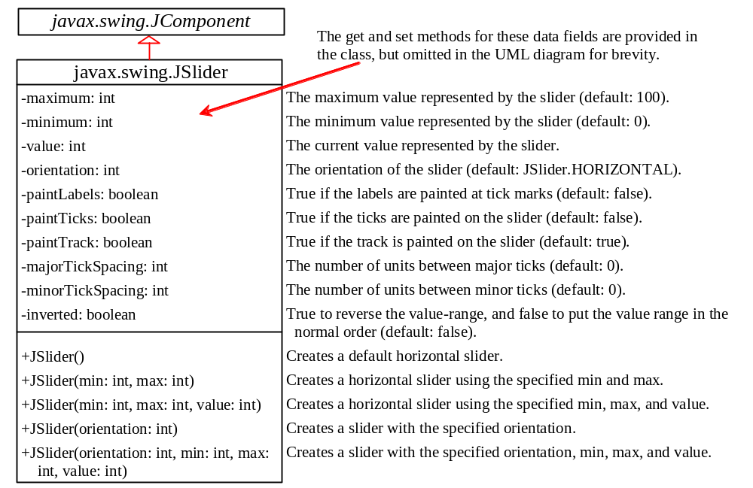
JSlider
JSlider is similar to JScrollBar, but JSlider has more properties and can appear in many forms.

Slide 48
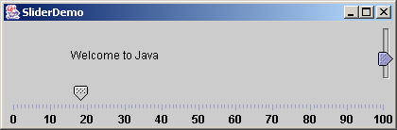
Example: Using Sliders
Rewrite the preceding program using the sliders to control a message displayed on a panel instead of using scroll bars.
SliderDemo
Run

Slide 49
Creating Multiple Windows
The following slides show step-by-step how to create an additional window from an application or applet.

Slide 50
Creating Additional Windows, Step 1
Step 1: Create a subclass of JFrame (called a SubFrame) that tells the new window what
to do. For example, all the GUI application programs extend JFrame and are subclasses
of JFrame.

Slide 51
Creating Additional Windows, Step 2
Step 2: Create an instance of SubFrame in the application or applet.
Example:
SubFrame subFrame = new
SubFrame("SubFrame Title");

Slide 52
Creating Additional Windows, Step 3
Step 3: Create a JButton for activating the subFrame.
add(new JButton("Activate SubFrame"));

Slide 53
Creating Additional Windows, Step 4
Step 4: Override the actionPerformed()
method as follows:
public actionPerformed(ActionEvent e) {
String actionCommand = e.getActionCommand();
if (e.target instanceof Button) {
if ("Activate SubFrame".equals(actionCommand)) {
subFrame.setVisible(true);
}
}
}

Slide 54
Example: Creating Multiple Windows
This example creates a main window with a text area in the scroll pane, and a button named "Show Histogram." When the user clicks the button, a new window appears that displays a histogram to show the occurrence of the letters in the text area.

Slide 55
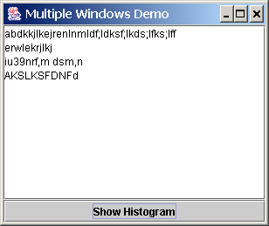
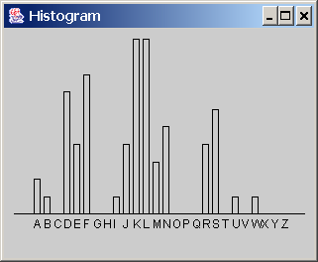
Example, cont.
MultipleWindowsDemo
Run
Histogram

